Slide 1

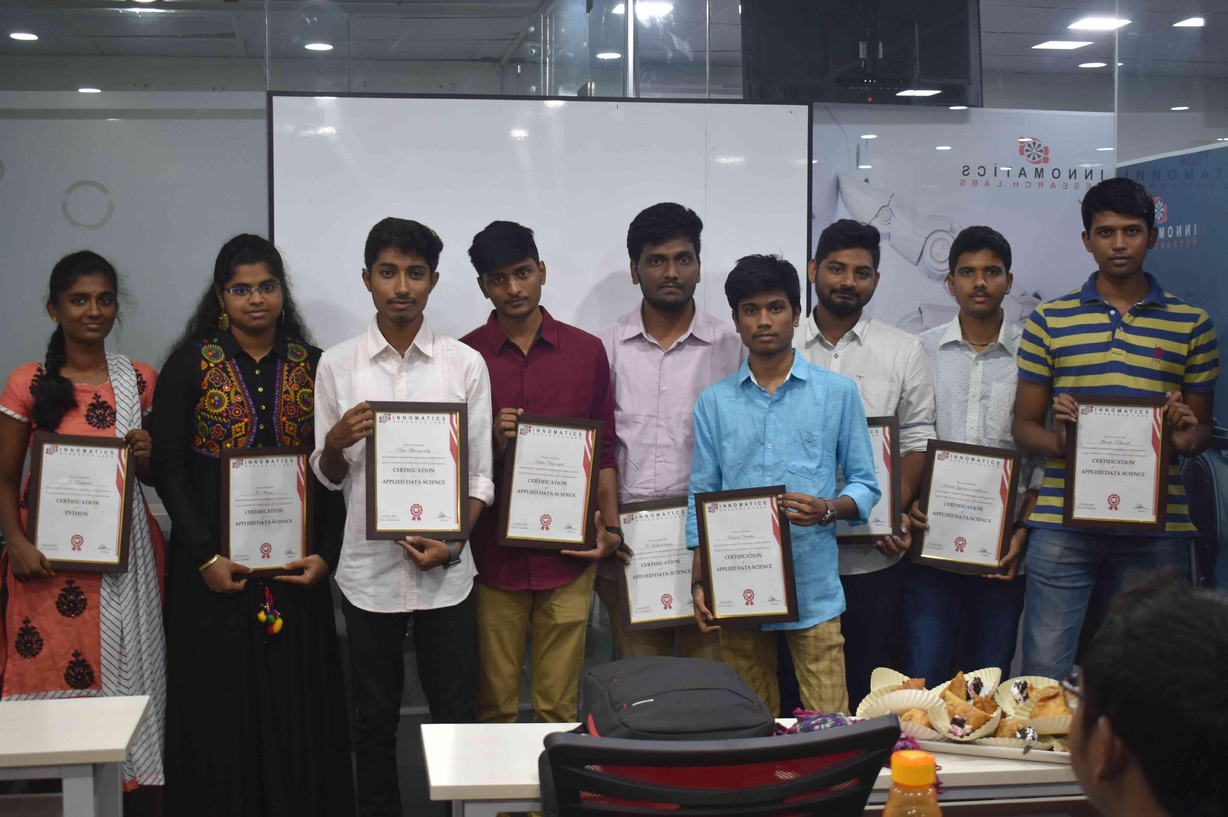
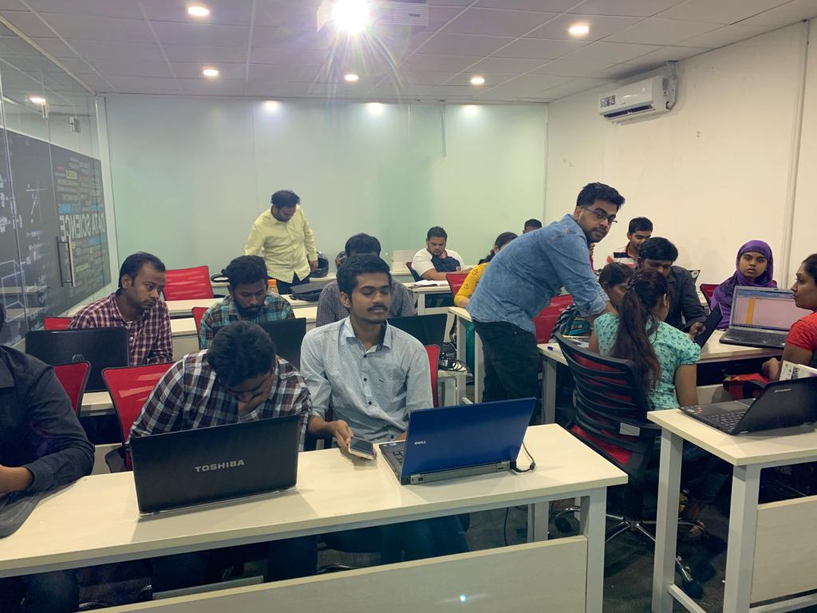

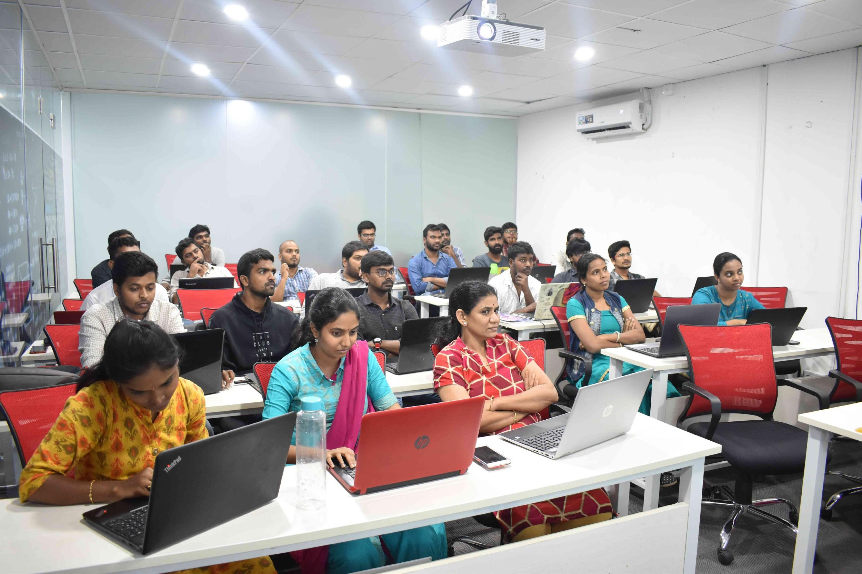
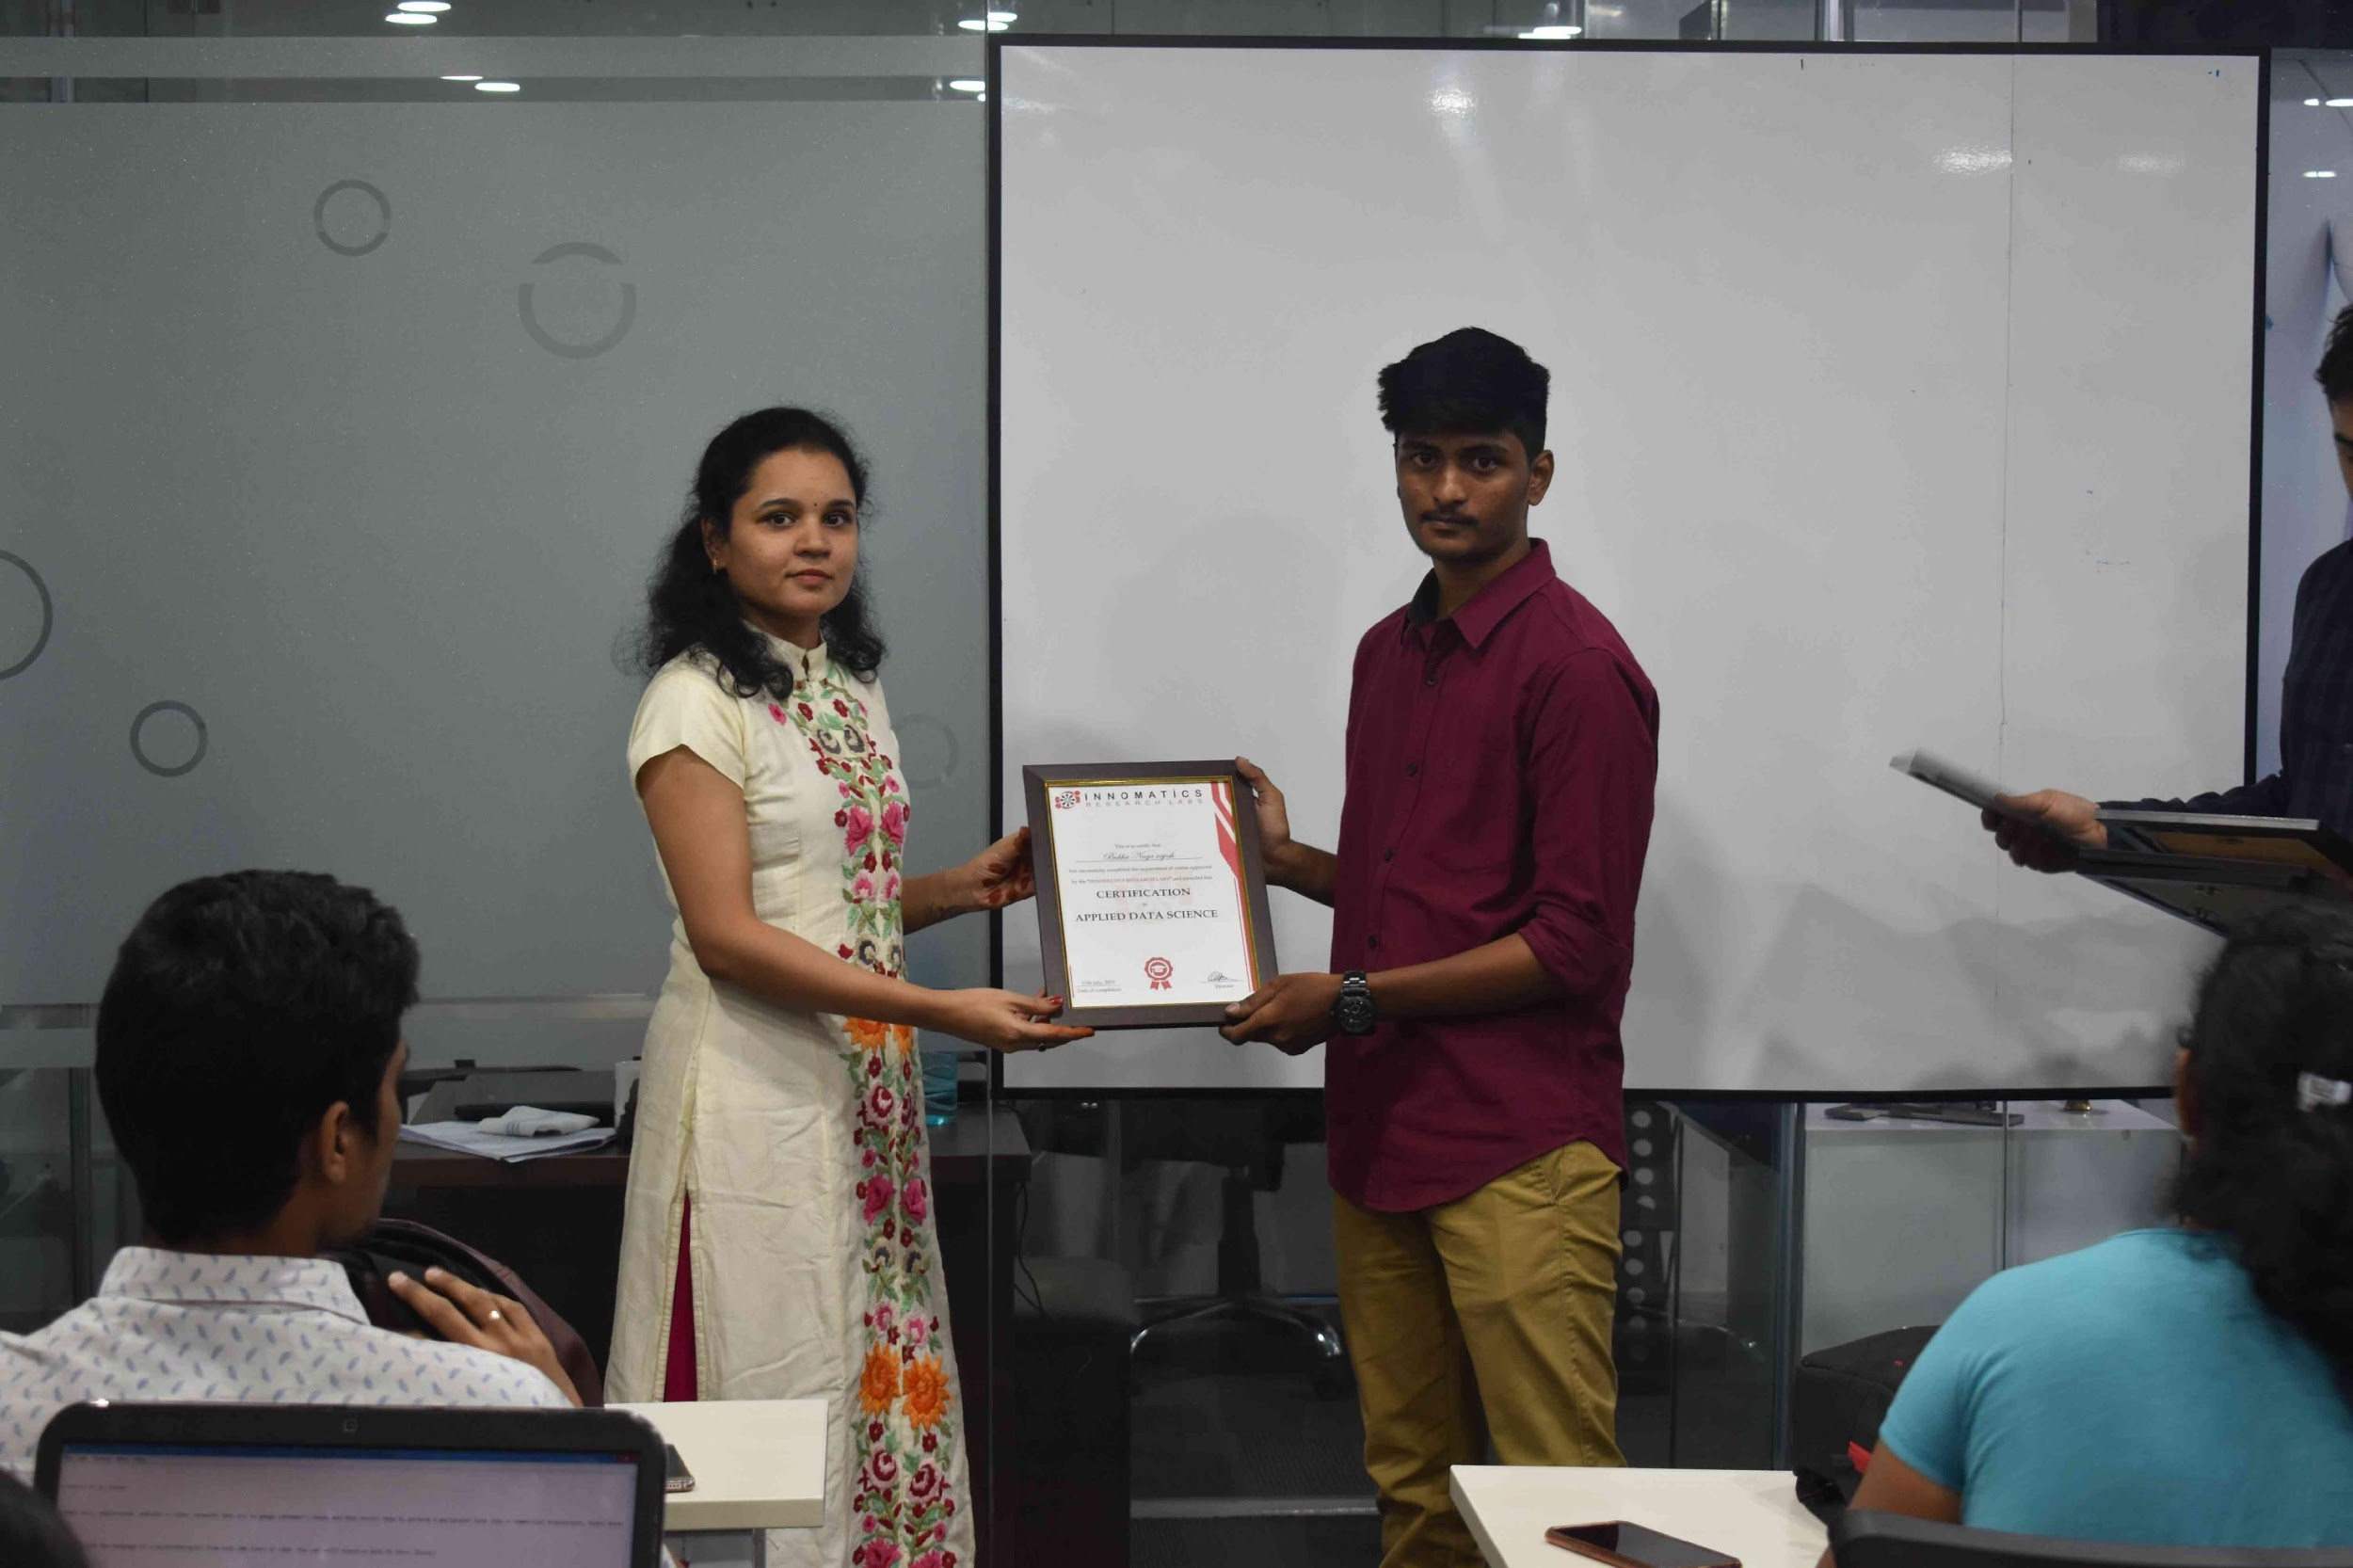
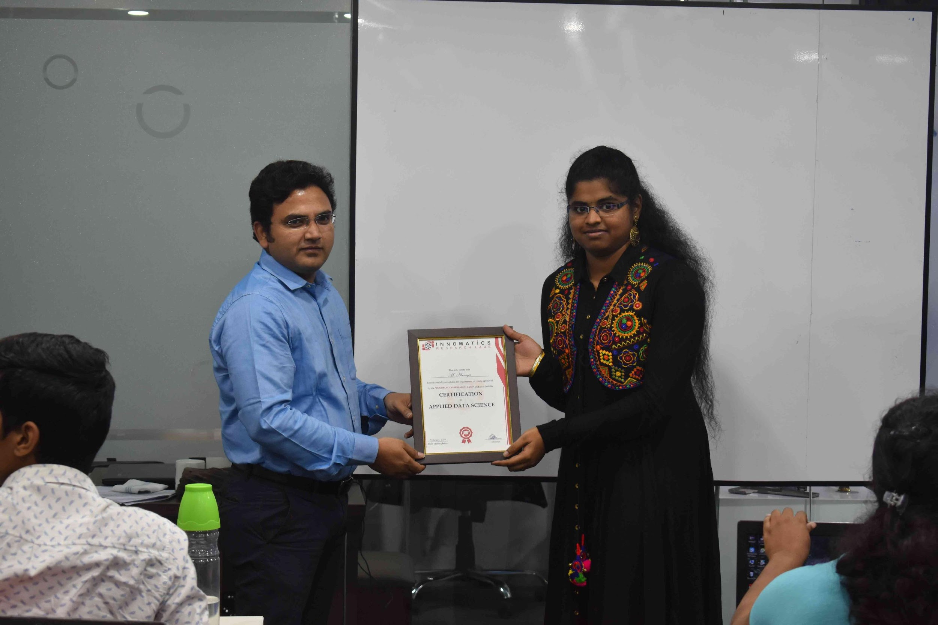

Slide 2

Descriptive Stats and Visualization
- By payal rajguru

Slide 3
STATISTICS AND ITS TYPES
STATISTICS
DESCRIPTIVE
INFERENCIAL

Slide 4
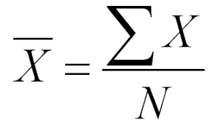
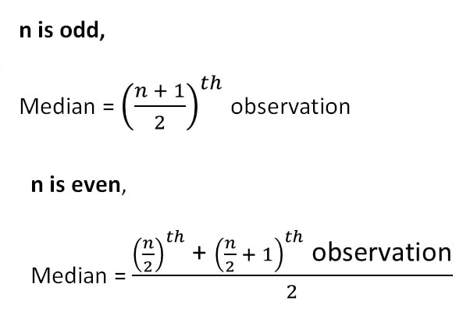
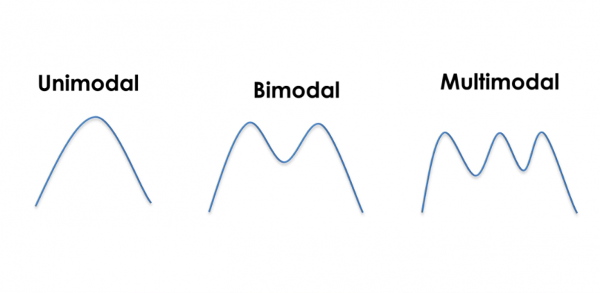
CENTRAL TENDENCY
CENTRAL TENDENCY
MEAN
MEDIAN
MODE

Slide 5
SHAPE
SHAPE
SKEWNESS
KURTOSIS

Slide 6
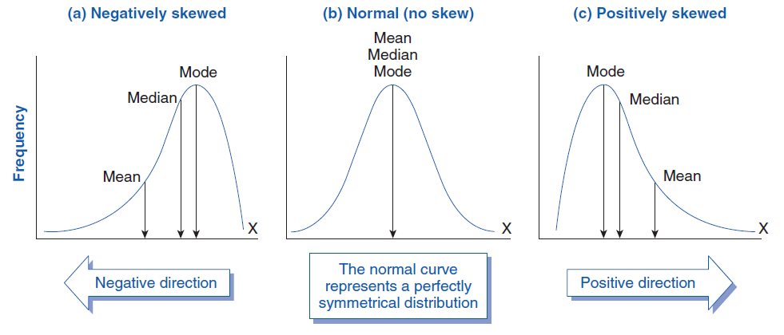
SKEWNESS

Slide 7
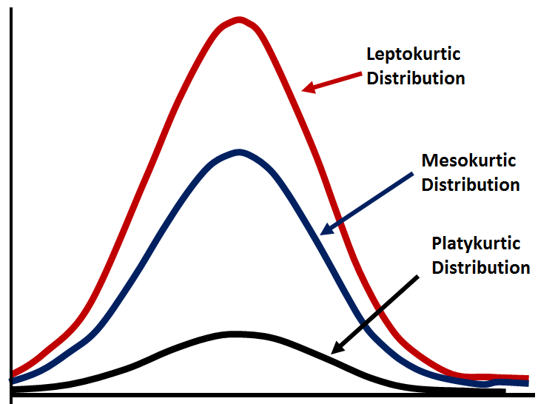
KURTOSIS

Slide 8
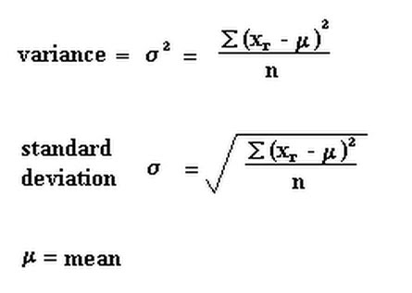

VARIANCE & STD.DEVIATION

Slide 9
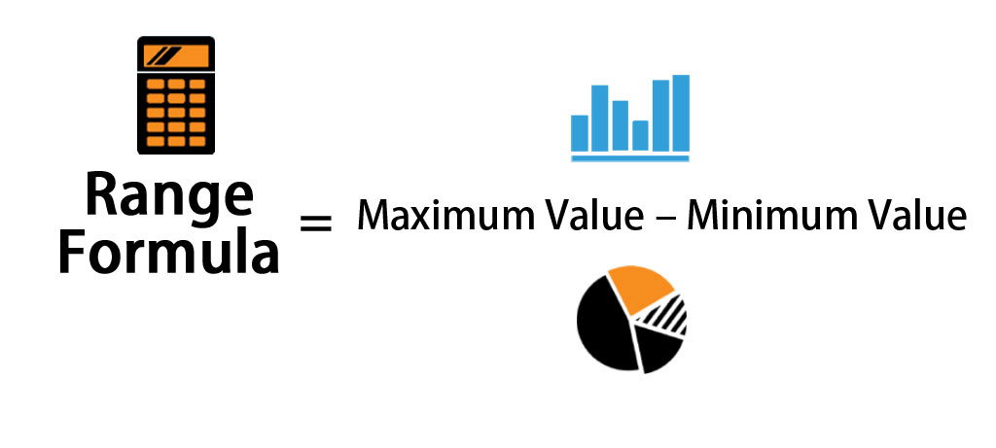
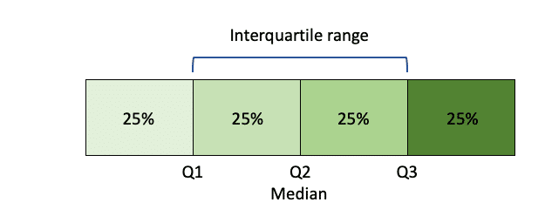
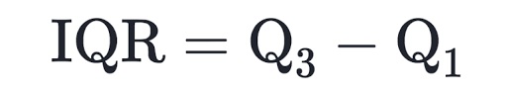
RANGE & INTERQUARTILE RANGE

Slide 10

Exploratory Data Analysis(EDA)

Slide 11
ABOUT DATASET
This is the dataset of ‘Aspiring Minds’ created by Aspiring Mind Employment Outcome 2015(AMEO).
This study is conducted primarily on students with engineering.
This dataset contains the employment details of engineering graduates.
There are both variables numerical and categorical column.
It has 3999 rows and 39 columns.

Slide 12
DATA CLEANING
Removed Irrelevant columns
Changed Datatypes
Replacing null values with median for numerical column and with mode for categorical column
Replacing similar values with single value

Slide 13
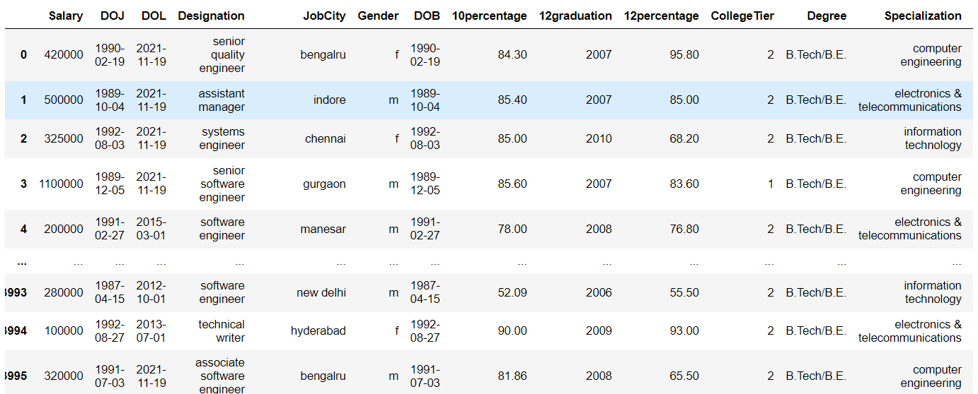
DATASET AFTER CLEANING

Slide 14
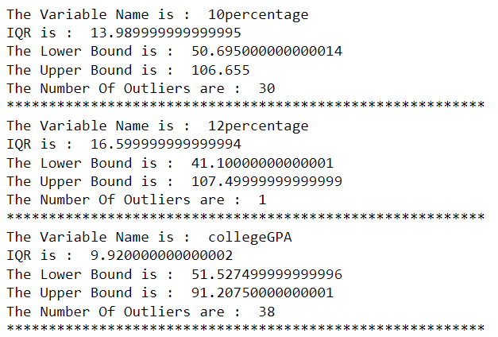
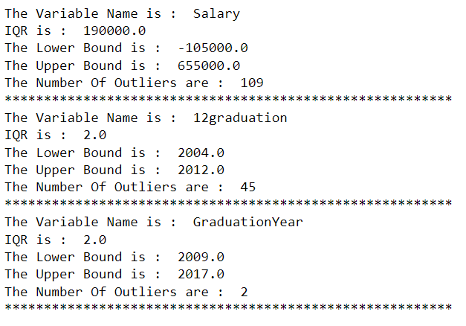
OUTLIERS
Which column has maximum number of outliers?
Salary
Which column has minimum number of outliers?
12percentage

Slide 15
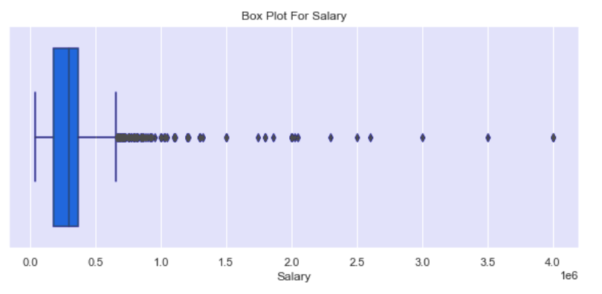
SALARY
What is the maximum salary an employee got?
40 Lakh
What is the minimum salary a employee got?
35000 Rs

Slide 16
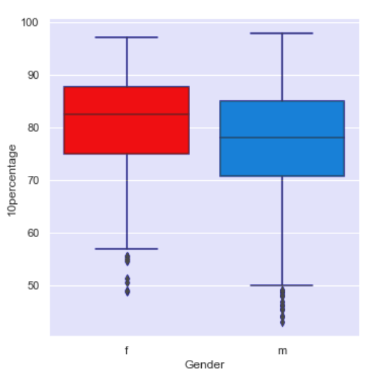
10th PERCENTAGE
GENDER VS 10TH PERCENTAGE
What is the maximum 10th percentage scored by employee?
97.76 %
What is the minimum percentage scored by employee?
43.0 %
Which gender got the highest percentage?
Males

Slide 17
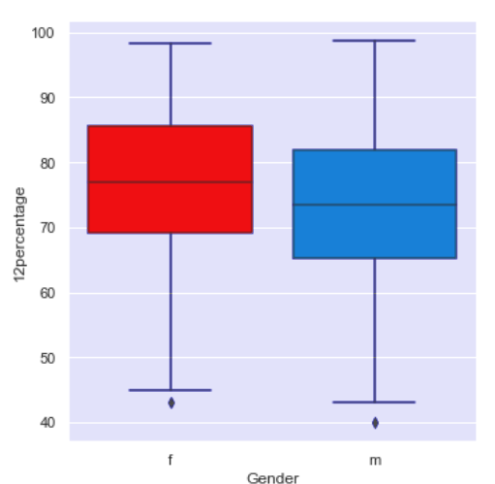
12th PERCENTAGE
GENDER VS 12TH PERCENTAGE
What is the maximum 12th percentage scored by employee?
98.7 %
What is the minimum percentage scored by employee?
40.0 %
Which gender got the highest percentage?
Males

Slide 18
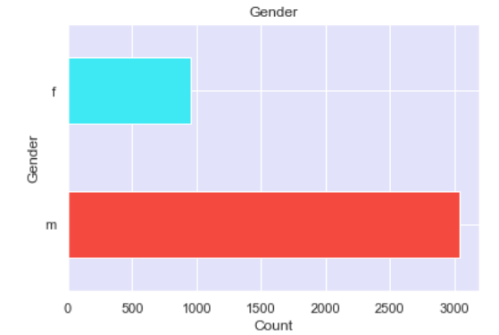
GENDER
Which Gender is most Employed?
Males are more employed
What number of males and female's are employed?
Out of 3999 students 3041 are male and 957 are female

Slide 19
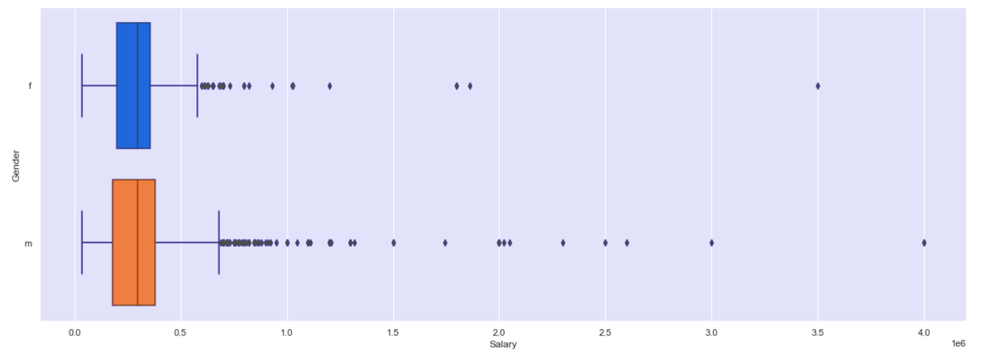
GENDER
Gender VS Salary
Which gender employee is having more salary ?
Males are having more salary.
What is the maximum salary that male employee are getting ?
40 lakh is the maximum salary
What is the maximum salary that the female employee are getting?
35 lakh is the maximum salary

Slide 20
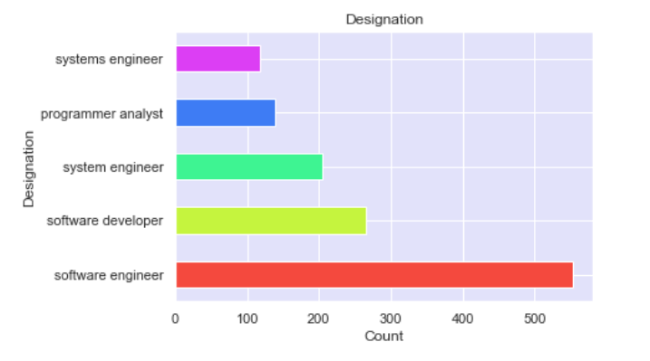
DESIGNATION
On what positions are most of them are employed?
Software Engineer position
How many employee are working as a software engineer?
553 are software engineer

Slide 21
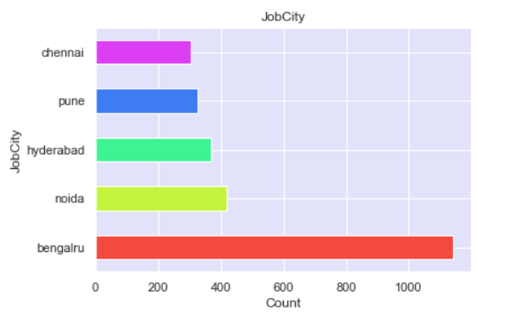
JOB CITY
In which city is employee most employed?
Bengaluru

Slide 22
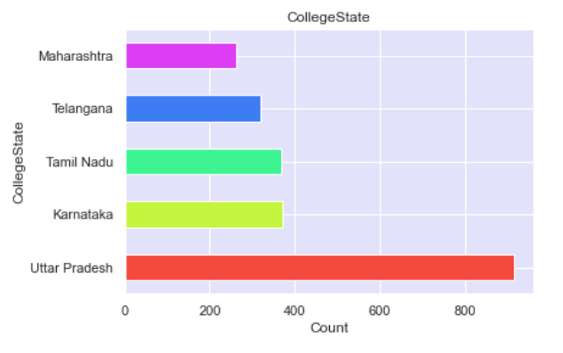
COLLEGE STATE
From which state employee are employed the most?
Uttar Pradesh

Slide 23
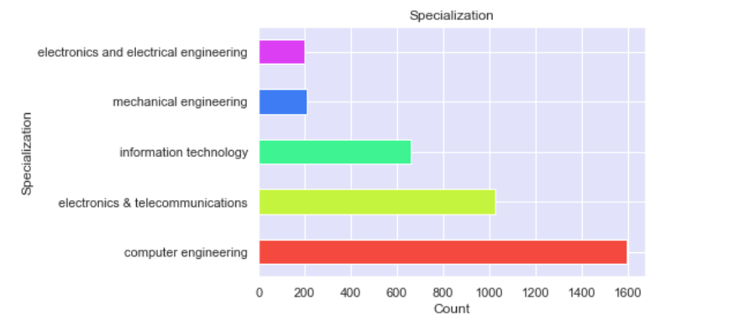
SPECIALIZATION
Employee are mostly specialized in which field?
Computer Engineering field

Slide 24
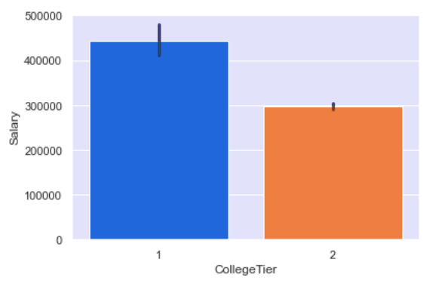
COLLEGE TIER
SALARY VS COLLEGE TIER
Which tier employee are getting most salary?
Tier 1

Slide 25
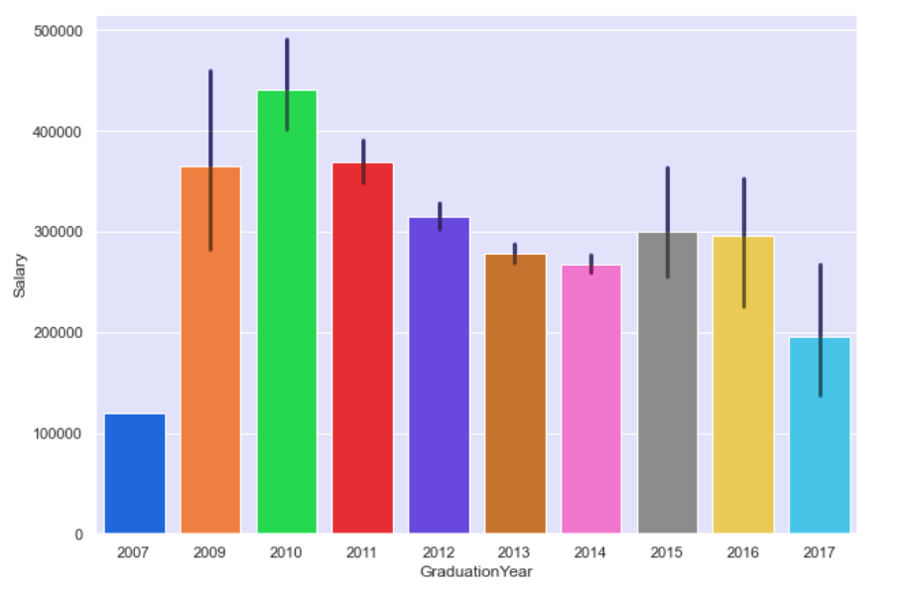
GRADUATION YEAR
SALARY Vs GRADUATION YEAR
Which graduation year employee are getting most salary?
2010
What is the maximum salary 2010 passout getting?
40 lakh

Slide 26
CONCLUSIONS
In all numerical column total of 225 outliers are present.
Males are more employes than females.
Out of 3999 employee 3041 are male and 957 are female.
Most of the employee are designated to software engineer position.
Most of the employee are employed in bengaluru
Most of the employee are employed from Uttar Pradesh.
Computer Engineering is the Specialization degree of most of the employee.
Tier 1 college employee are highest paid
2010 graduate is getting highest salary of 40 lakh

Slide 27

Thank you

